Slide 1

Ellyse: Your Virtual Ace
Streamline your digital life with Ellyse voice Assistant.
Ayush Kumar
35113302722
C.S.E. 5B

Slide 2
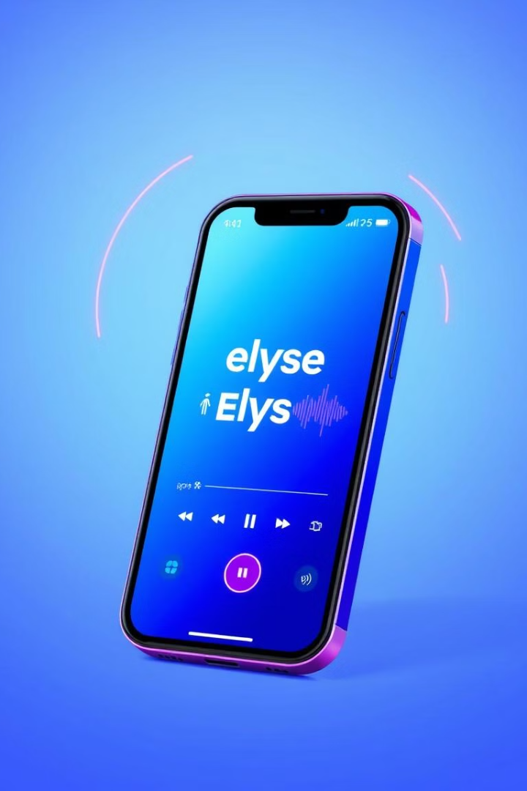

Introduction
1
Voice-Controlled
Effortless task management.
2
Seamless Integration
Automates your workflow.
3
Versatile
Browse, manage, and control.

Slide 3

Architecture and Technologies
Modules
Integrations
SearchNow, Core Logic, Features.
Webbrowser, Wikipedia, Pywhatkit.
Technologies
Python, Pyttsx3, SpeechRecognition.

Slide 4

Genesis of Ellyse: Your Virtual Ace
Ellyse was create out of a desire to address the challenges students face in managing their time and productivity.

Slide 5

Ellyse: Designed to Optimize Student Productivity and Focus
1
Personalized Study Routines
2
Focus Enhancement
Ellyse offers features to minimize distractions and enhance focus, allowing students to dive deep into their studies.
Ellyse helps students create and manage effective study schedules, tailored to their individual needs and learning styles.
3
Smart Information Retrieval
Ellyse provides quick access to relevant learning resources and information, making research and study more efficient.

Slide 6
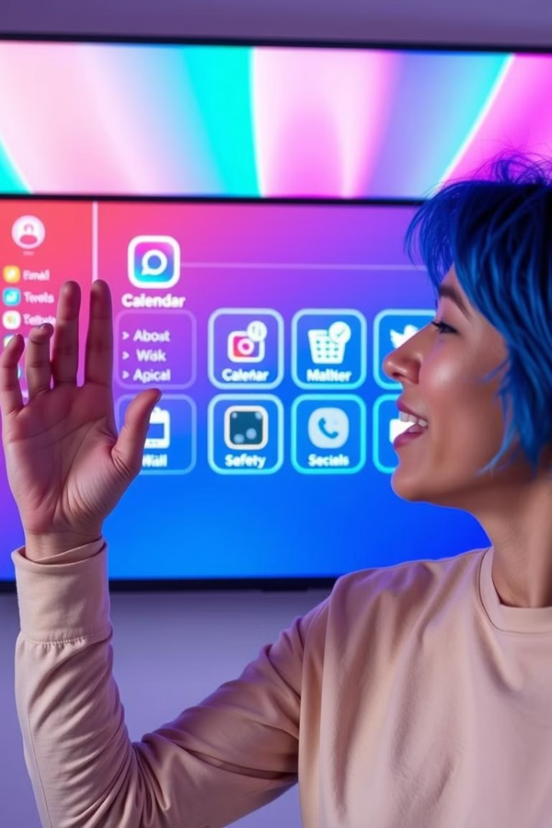




Key Features
System Control
Manage device settings.
App Control
Open and close apps.
Focus Mode
Boost productivity.
Messaging
Send WhatsApp messages.

Slide 7

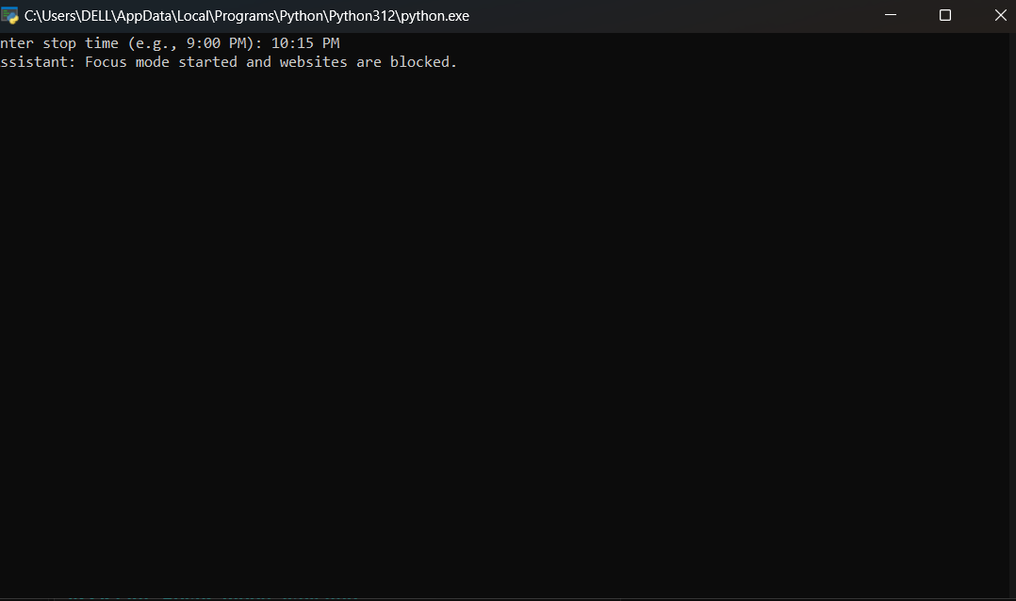
Focus Mode
1
Distraction Blocking
Enhanced concentration.
2
Customizable Timer
Set break intervals.
3
Effective Time Management
Optimize study sessions.

Slide 8

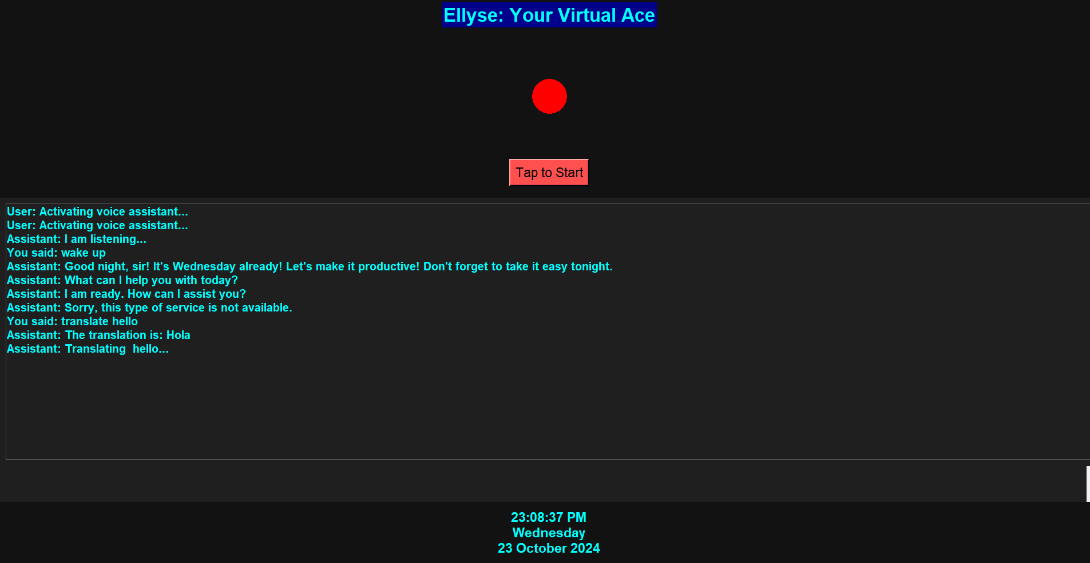
Translator
Real-Time Translation
Translate any language.
Voice Input
Speak to translate.
Example
"Translate 'hello' to Spanish."

Slide 9



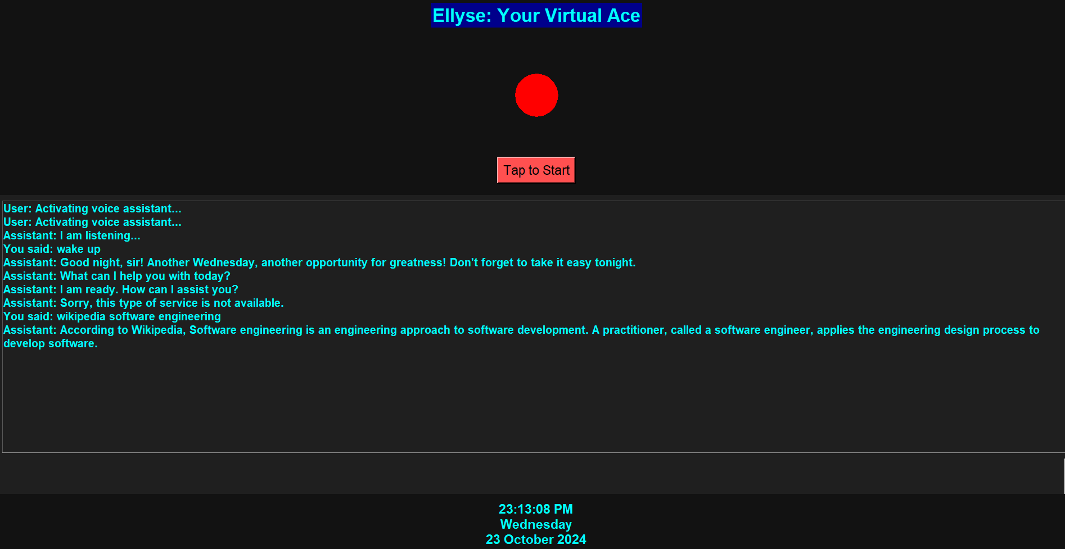


Advanced Search
Google
Comprehensive search.
Wikipedia
Quick information access.
Twitter
Real-time updates.
YouTube
Video content search.

Slide 10

WhatsApp Messaging
Hands-Free Messaging
Send messages easily.
Voice Commands
Specify recipient & message.
Example
"Message John: Meeting at 5."

Slide 11



System Control
Volume
Media
Brightness
Adjust audio levels.
Control playback.
Adjust screen brightness.

Slide 12



Use Case Scenarios
Student
Professional
Casual User
Use Focus Mode to concentrate during study sessions. Set reminders for assignments and deadlines.
Manage meetings, emails, and tasks through voice commands. Control device settings and apps with ease.
Play music, control videos, and send quick messages. Access information and entertainment with voice commands.

Slide 13
Advantages & Disadvantages
Advantages
Disadvantages
Student-Focused
Voice Recognition Issues
Multifunctionality
Dependency on Internet
Hands-Free Experience
Limited Offline Functionality
Ellyse prioritizes student needs, offering features for study management, reminders, and productivity. Its diverse functionality combines messaging, media control, study routines, and web searches. Voice commands provide a convenient and time-efficient solution.
Ellyse might struggle with accents or unclear speech. Features like search integration and WhatsApp messaging need internet access. Without the internet, some advanced features like search won’t work.

Slide 14

Future Scope
AI-based study recommendations
Enhanced personal assistant tools
Integrated cloud sync for cross-device functionality

Slide 15

Conclusion
Effortless Management
Ellyse is a voice-controlled assistant that streamlines daily tasks.
Productive Features
Features such as media control, focus mode, and advanced search enhance productivity.
Future Enhancements
Ellyse is expected to expand and offer more features in the future.

Slide 16

Thank You
Thank you for your attention! Feel free to ask any questions or explore Ellyse's full capabilities.

